Slide 1

CONSUMER BANKRUPTCY IN THE COVID-19 ERA
The Virtual Seminar will begin momentarily.
DON’T FORGET - Call AT&T Teleconferencing for the audio.
Phone: (888) 363-4749
Access Code: 9873511#
Please Don’t Attempt to Unmute Your Line During the Conference

Slide 2
WELCOME!
A Verification Code will be provided by the Presenters for each session of this seminar. Please write down each Code when you hear them. They are necessary to obtain the CLE credits and will not be provided after the seminar has concluded.

Slide 3


CARES ACT Changes to the Bankruptcy Code
Presented by
John G. Jansing, Dayton Chapter 13 Trustee in Dayton
Scott G. Stout, Attorney to the Dayton Chapter 13 Trustee
Erin Renneker, Dayton Chapter 7 Trustee
1

Slide 4

Exclusion of Stimulus Payments from income and disposable income
2
Coronavirus Aid, Relief, and Economic Security (CARES) Act of 2020 (the “Act”)
§1113(b)(1) provides that “stimulus” payments paid under Federal law with respect to COVID-19 are excluded from the statutory definitions of current monthly income and disposable income
Recovery rebates received within six months before the filing of a bankruptcy petition should not be included in calculating a debtor’s CMI in a chapter 7 or chapter 13 case, and should be excluded from projected disposable income available to pay creditors through a chapter 13 plan
2

Slide 5

Allowance of plan modifications due to material financial hardship arising out of coronavirus epidemic, including extension of plan completion to 7 years
The CARES Act adds subsection (d)(1) to 11 U.S.C. §1329
This amendment permits a debtor to modify a confirmed plan, after notice and a hearing, if such debtor is experiencing a “material financial hardship” due “directly or indirectly” to the COVID-19 pandemic. The affected debtor may modify the plan up to seven years (84 months) from the first payments under the original confirmed plan became due
Can modify plans that were confirmed prior to the enactment date, which was March 27, 2020.
3

Slide 6

Deferral of student loan payments for 6 months through September 30, 2020
Secretary of Education is required to “suspend all payments due” for federally held student loans until September 30, 2020 and “interest shall not accrue” during that time
The Secretary shall deem each month for which a loan payment was suspended under the CARES Act as if the borrower of the loan had made a payment for the purpose of any loan forgiveness program or loan rehabilitation program
Affect of suspended payments on IDR’s
4

Slide 7

Increase of small business reorganization eligibility to $7.5 million
CARES Act expands eligibility under the Small Business Reorganization Act of 2019 (SBRA)
§1113 amends SBRA to allow a business which has debt up to $7.5 million to qualify for filing (original debt limit was $2,725,625)
The increase in the debt threshold to $7.5 million will expire and return to the original debt limit after one year
5

Slide 8

covid-19 rebate payments not to be administered by trustee per united states trustee
CARES Act is silent as to whether recovery rebates are property of the bankruptcy estate
In rare chapter 13 cases filed on or after March 27, 2020, the recovery rebate may by relevant to the confirmation standard of 11 U.S.C. §1325(a)(4). For chapter 13 cases filed before that date, the recovery rebate is excluded from that analysis
Trustees have been directed to notify their UST prior to taking any action to administer recovery rebates or to object to a chapter 13 plan based on debtor’s treatment of the recovery rebate
6

Slide 9

1-year sunset of cares act provisions
CARES Act temporarily modifies provisions of the bankruptcy code
The modified provisions have a one-year sunset from the enactment of the CARES Act
Affect on bankruptcy planning and advice
7

Slide 10

Answers to previously submitted questions
8

Slide 11


Local Bankruptcy Court COVID-19 General Orders, Chapter 13 Plan Amendments, and Mortgage Modification Mediation
Presented by
The Honorable Guy R. Humphrey, United States Bankruptcy Court
The Honorable Beth A. Buchanan, United States Bankruptcy Court
9

Slide 12
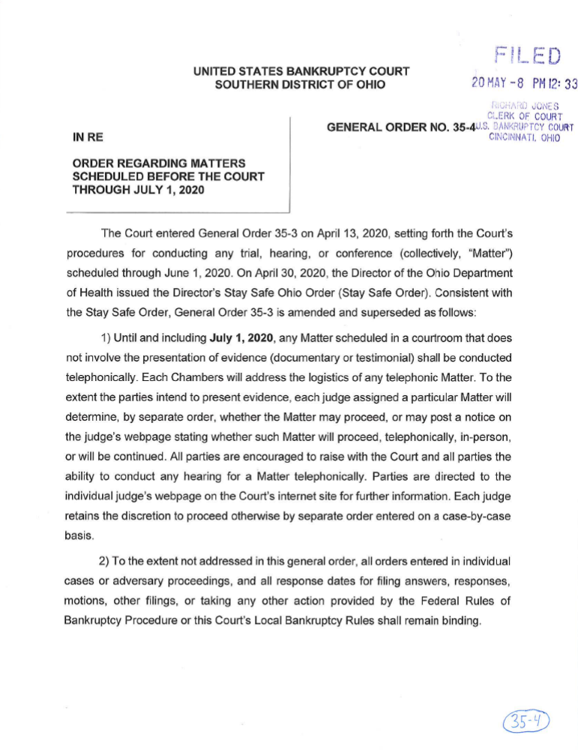
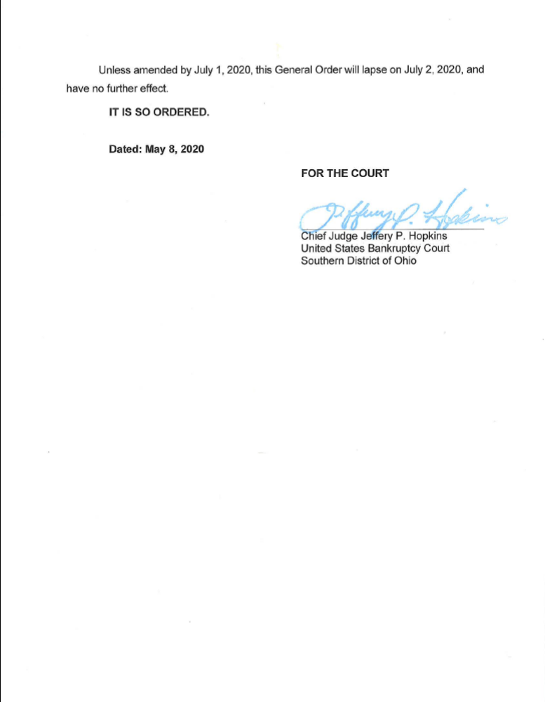
10

Slide 13
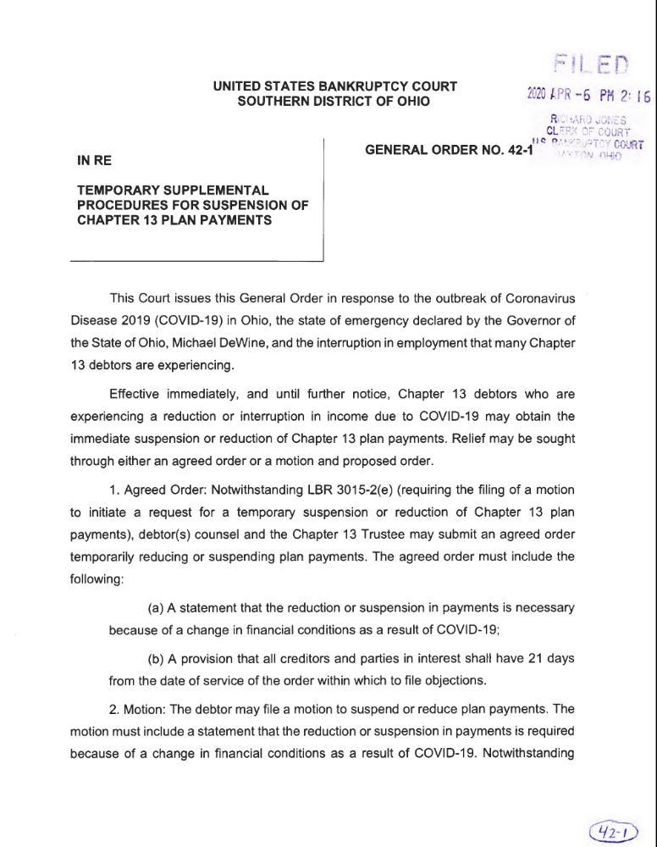
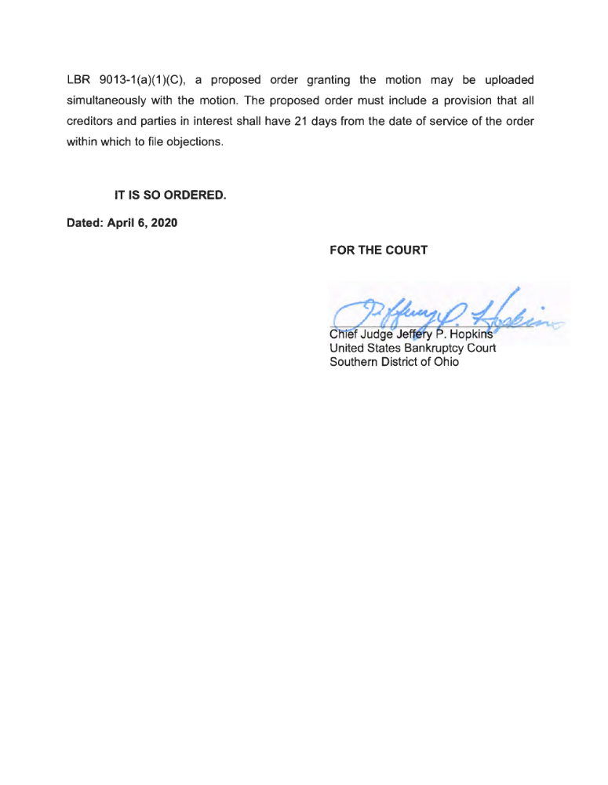
11

Slide 14
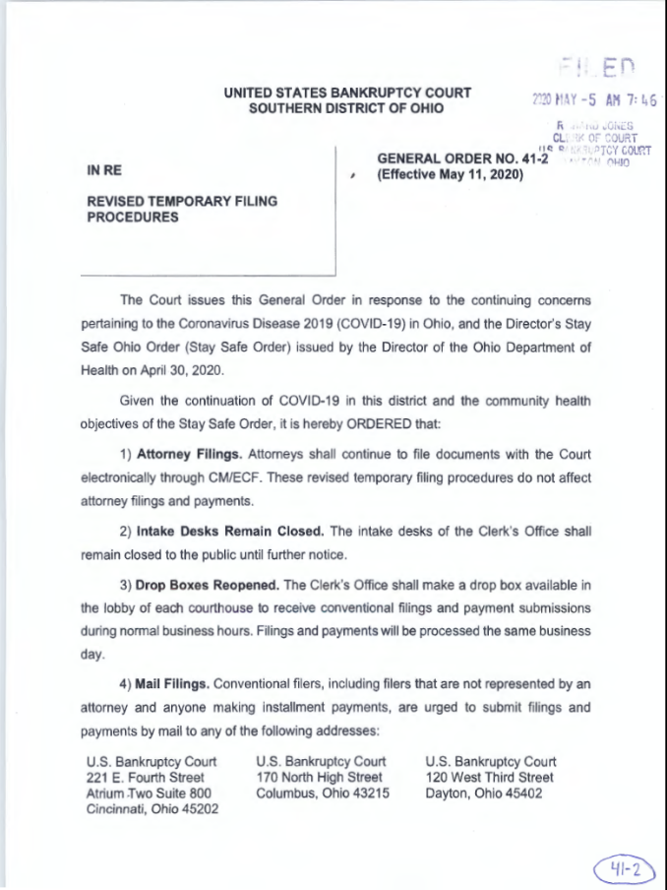
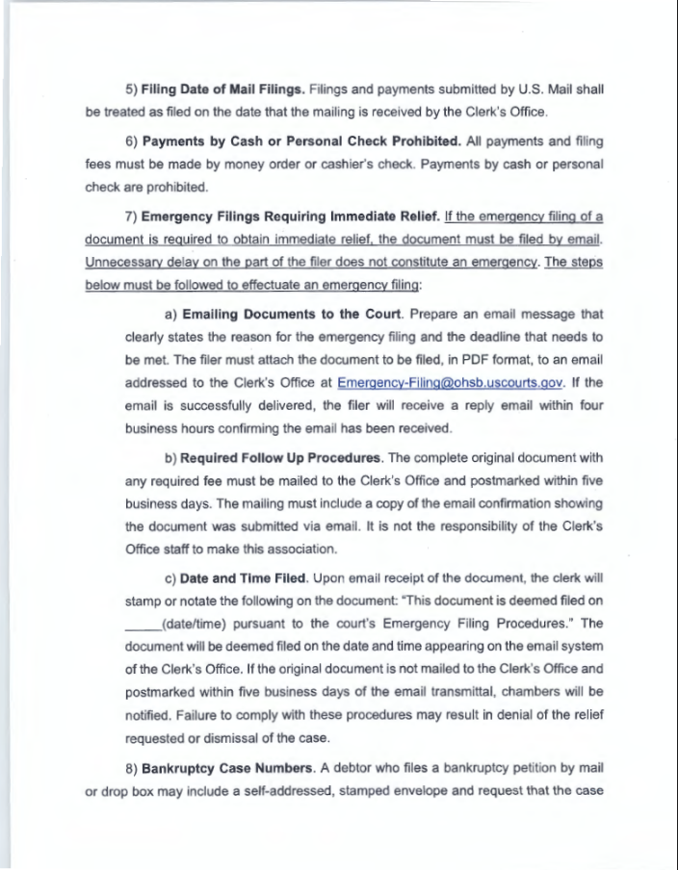
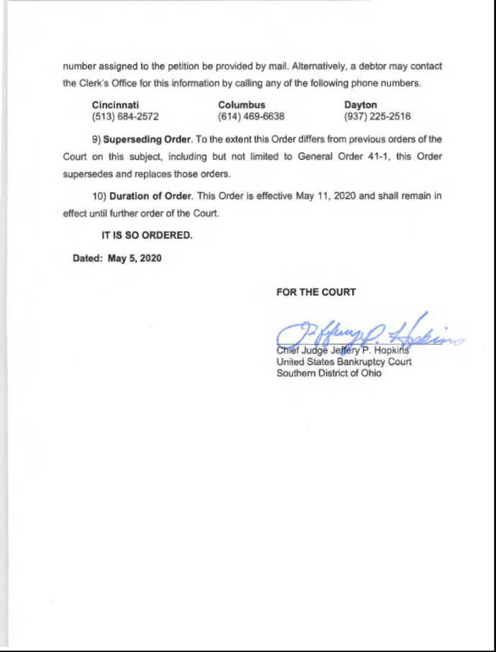
12

Slide 15
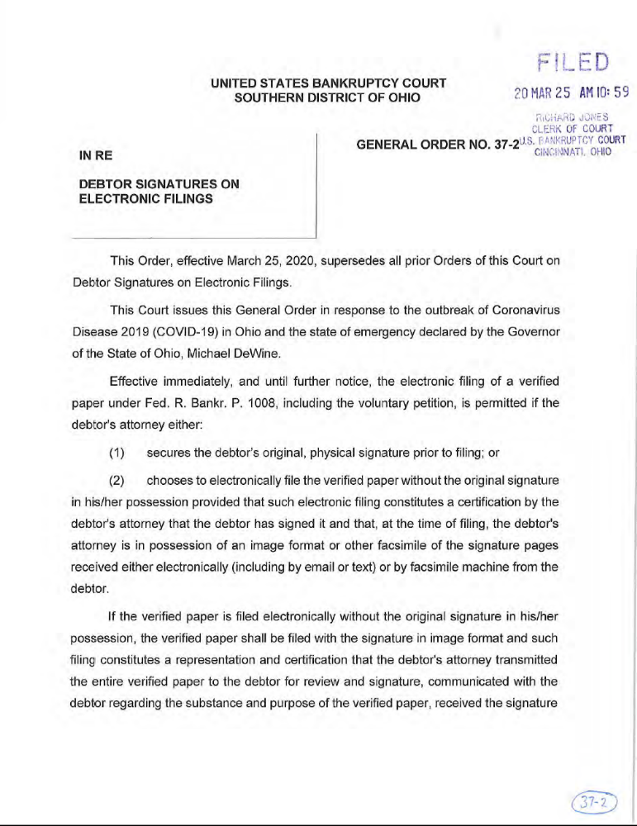
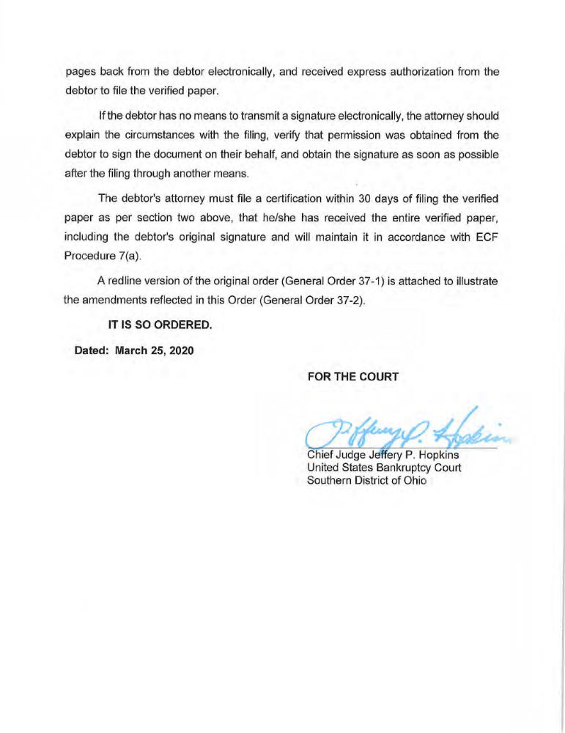
13

Slide 16
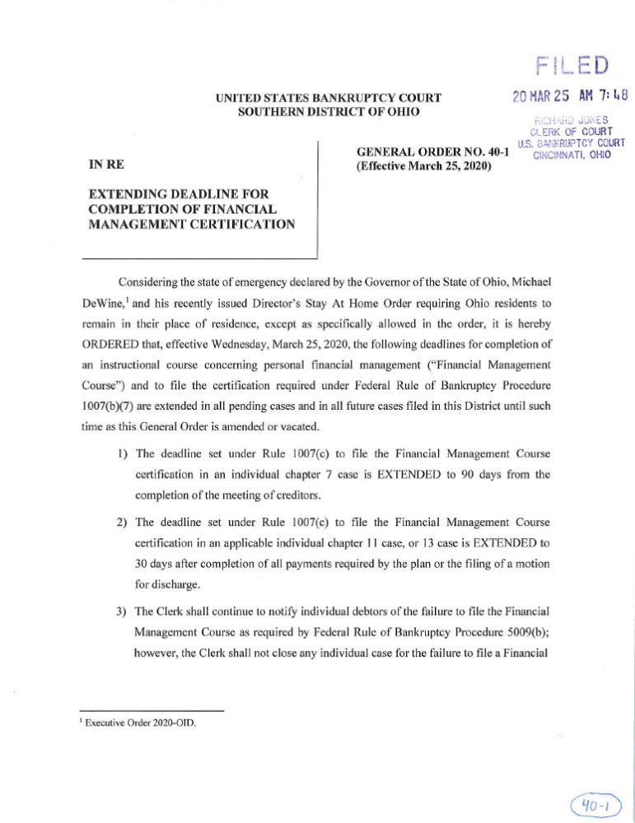
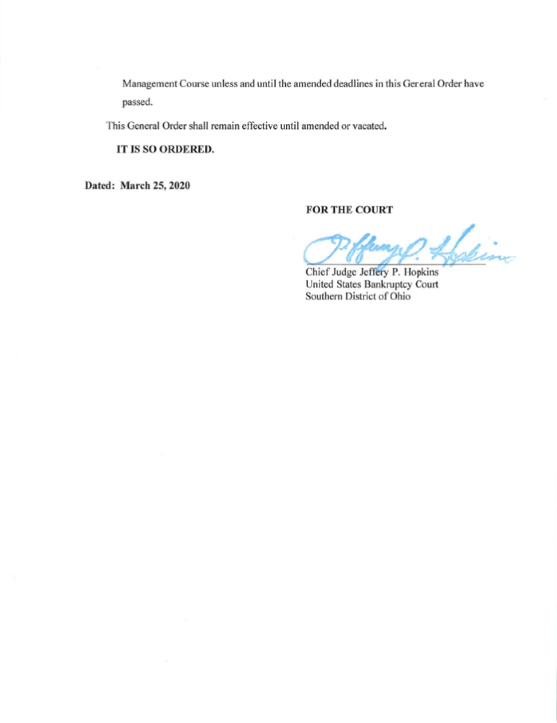
14

Slide 17
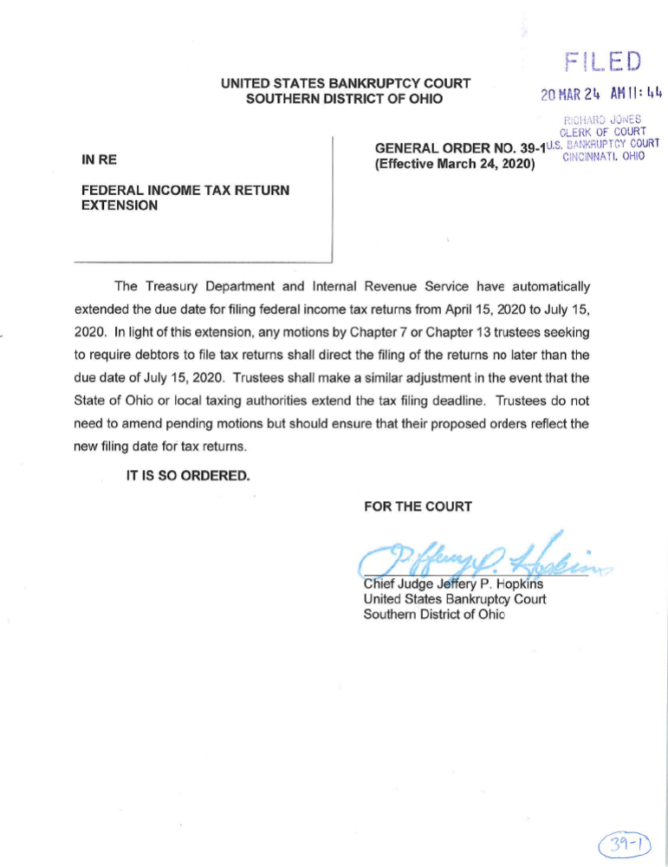
15

Slide 18
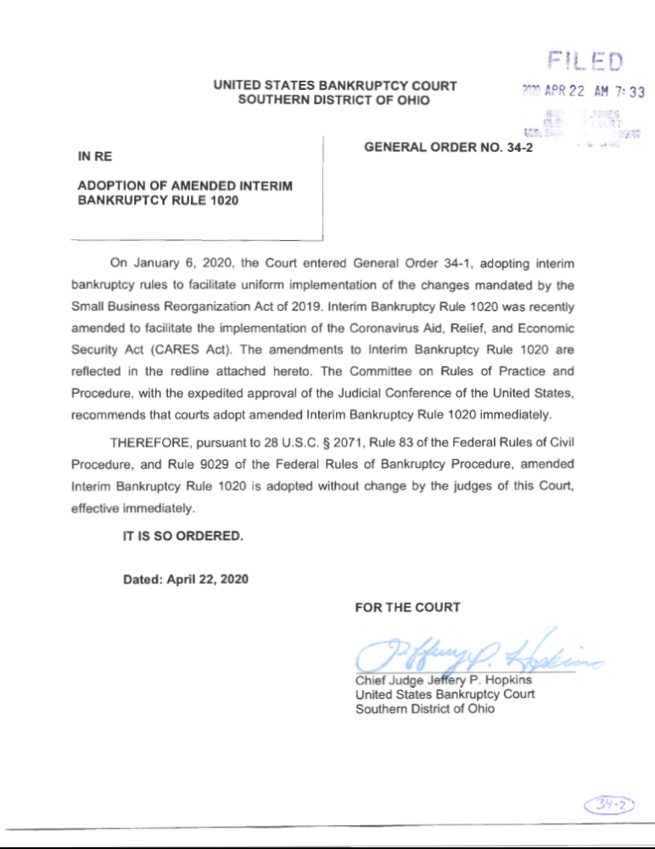
16

Slide 19
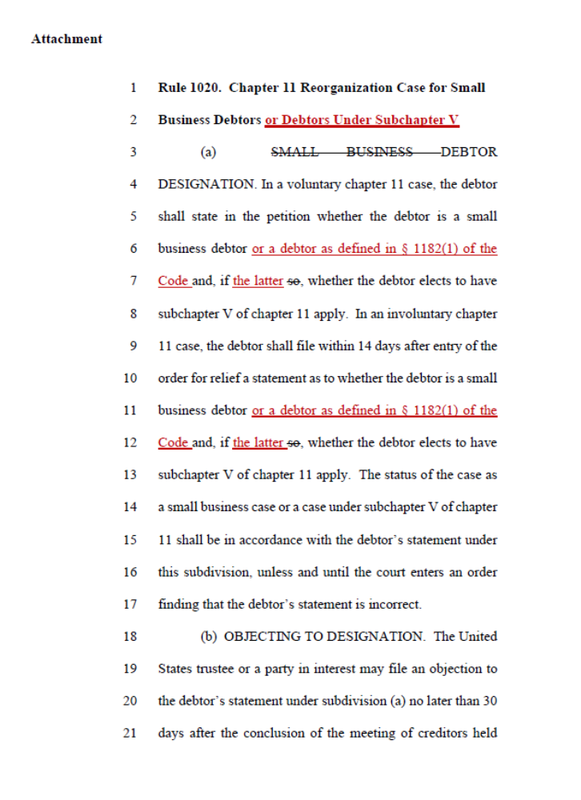
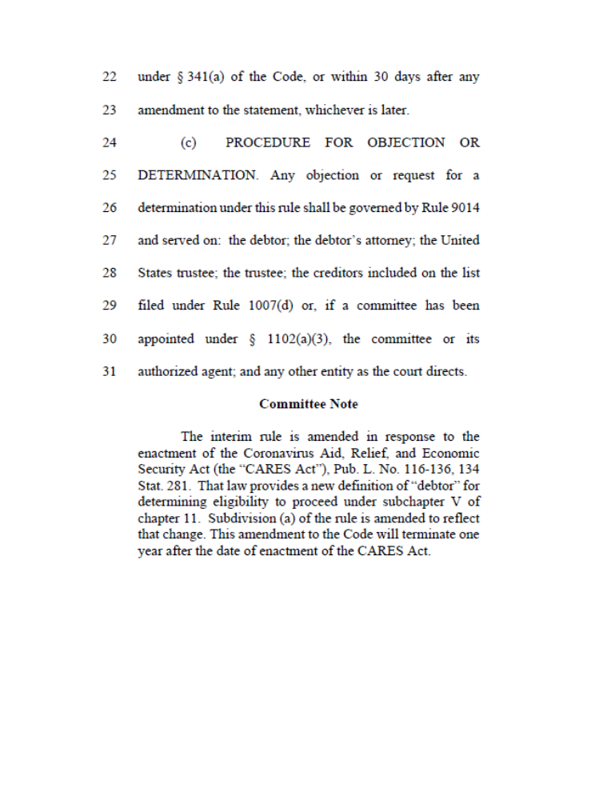
17

Slide 20
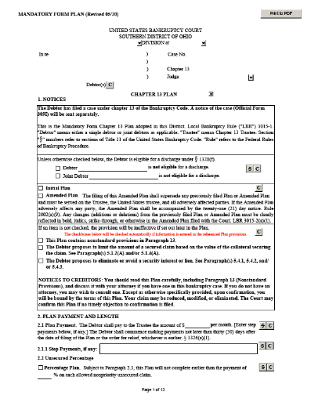
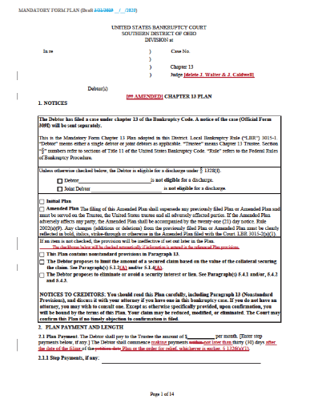
Local Bankruptcy Court COVID-19 General Orders, Chapter 13 Plan Amendments, and Mortgage Modification Mediation
Presented by
The Honorable Guy R. Humphrey, United States Bankruptcy Court
The Honorable Beth A. Buchanan, United States Bankruptcy Court
18

Slide 21


Chapter 13 Trustee Procedures in the COVID-19 Era
Presented by
John G. Jansing, Dayton Chapter 13 Trustee in Dayton
Scott G. Stout, Attorney to the Dayton Chapter 13 Trustee
19

Slide 22

Telephonic §341 Meetings
The United States Trustee has directed trustees to conduct telephonic §341 meetings for all cases filed through July 10, 2020
This means Telephonic meetings may run through the end of August, 2020
There may be an issue knowing whether a meeting is being held telephonically or if debtors are to attend the meeting in person
20

Slide 23

Payment issues
Due to COVID-19 pandemic, the Chapter 13 Office in Dayton has extended its review of plan delinquencies from 60 days to 90 days
Contact Scott with questions regarding this procedure
21

Slide 24

Informal Request for Debtor refunds
Debtors can make a request for refund of monies paid into their plan
Requests must be due to a financial hardship directly or indirectly related to the COVID-19 pandemic
Send the request letter to Gina in our office
22

Slide 25
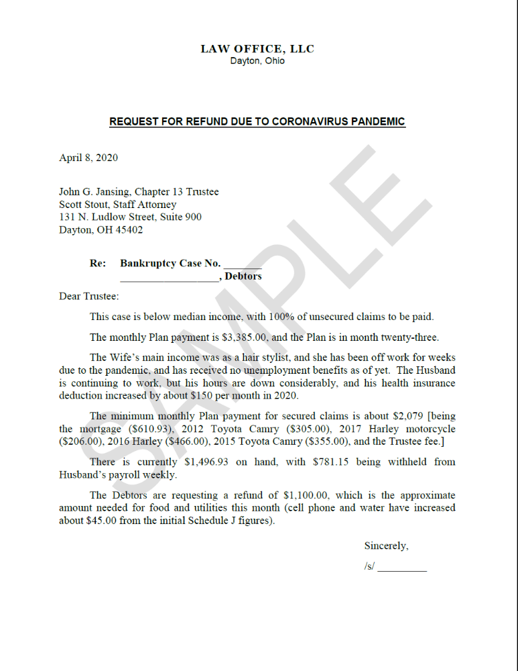
23

Slide 26
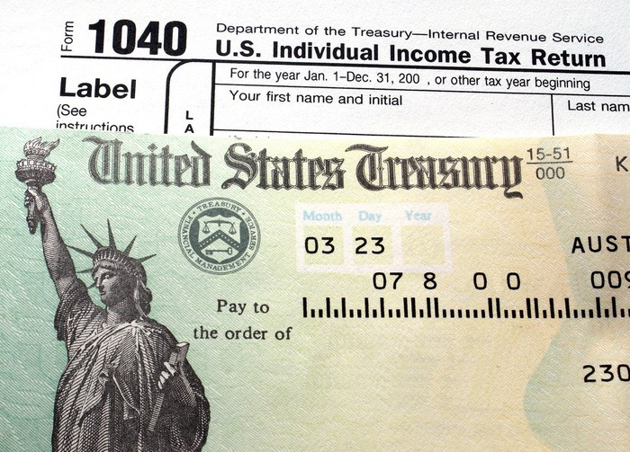
Tax Refunds, returns and motions to retain tax refund monies
Suspended unwritten rule of on1y 1 motion to retain tax refund
Motion must show proof
of need
Requirement of status report
after monies are spent
24

Slide 27

Mortgage Forbearance
§4022(b) of CARES Act allows a borrower of a federally back mortgage loan to seek a 6 month forbearance
Know the difference between Forbearance and Deferral. Talk to your debtor and have a plan in plan
Expect and email from the Chapter 13 Office when a forbearance notice is filed on a Trustee disburse mortgage
Watch for notices being filed by mortgage lenders without debtor requests
25

Slide 28
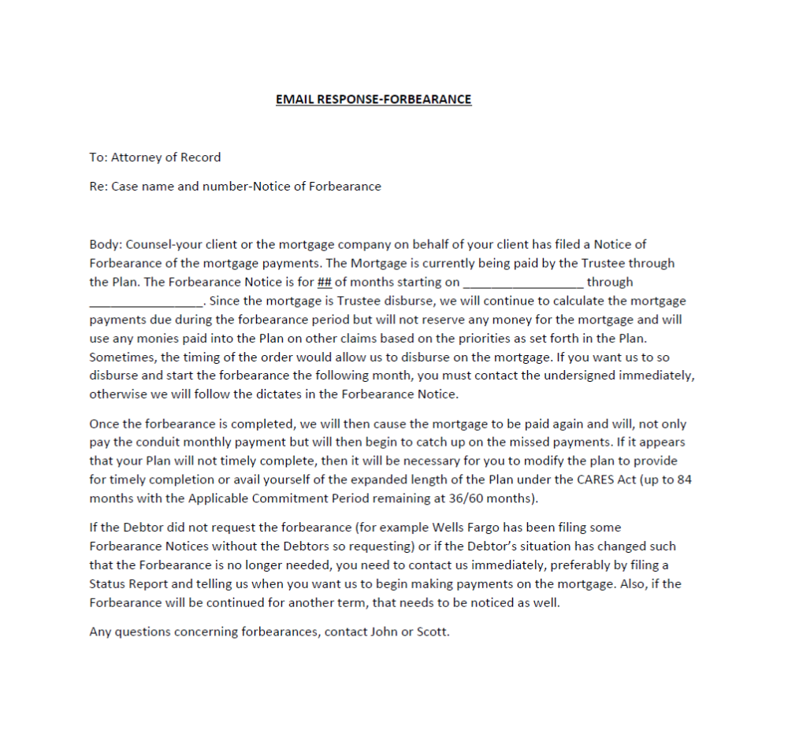
26

Slide 29

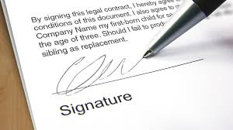
341 documents
Documents are being emailed to attorneys prior to the §341 docket
Obtaining debtors’ authorization to sign payroll and tax orders at the §341 meeting
Make sure to return documents to the Chapter 13 Office in a timely fashion
27

Slide 30

Challenge to the CARES Act
Equal protection
Confirmed
v.
Non-Confirmed
Cases
28

Slide 31

Answers to previously submitted questions
29

Slide 32


BREAK
We are taking a 15 minute break and will resume at 3:00 p.m. Please stay with us for Chapter 7 Trustee Procedures in the COVID-19 Era and Tips on Filings and Submissions.

Slide 33

Chapter 7 Trustee Procedures in the COVID-19 Era
Presented by
Paul Spaeth, Dayton Chapter 7 Trustee
Erin Renneker, Dayton Chapter 7 Trustee
Telephonic 341 Meetings
Providing Documentation to the Chapter 7 Trustees
Other Trustee Issues and Procedures
30

Slide 34


Tips on Filings and Submissions
Presented by
Colleen Militello, Law Clerk to Judge Buchanan
Neil Berman, Law Clerk to Judge Humphrey
Ryan Cunningham, Law Clerk to Judge Buchanan
31

Slide 35

American BANKRUPTCY LAW FORUM
Tips on flings and submissions
Neil Berman, Law Clerk to Judge Guy R. Humphrey
Ryan Cunningham, Law Clerk to Judge Beth A. Buchanan
Colleen Militello, Law Clerk to Judge Beth A. Buchanan
32

Slide 36

General Docketing Issues
When filing an ECF document with the Court, the attorney who signs the document must be the one who files that document in ECF. You cannot use another attorney’s login and password. This applies even when the attorneys are in the same firm.
Use of the correct docketing event is important for reporting and noticing purposes.
  Improper use of the “Generic Motion” docketing event. Very few motions or applications should be docketed using the “Generic Motion” docketing event.
  Documents filed using a generic docketing event must include additional language identifying the nature of the filing (e.g. Application to Settlement Personal Injury Claim and for Compensation of Special Counsel).
A list of docketing events sorted by event type is available on the Court’s website at https://www.ohsb.uscourts.gov/pdffiles/AttorneyDocketingEvents.pdf
33

Slide 37
B. Chapter 13 Plan Issues
Most Commonly Occurring Plan Issues that Lead to Court Action (Email to Counsel or Sua Sponte Objection from the Court)
Check Boxes on Front Page
Failure to Fill in the Cramdown / Lien Avoidance Provisions Fully
Attempting to Cramdown Government Claim By Plan
Attempting to Avoid Government Lien Before Claim Filed / Deadline Expired
Failure to Indicate Proper Rule 7004 Service
34

Slide 38

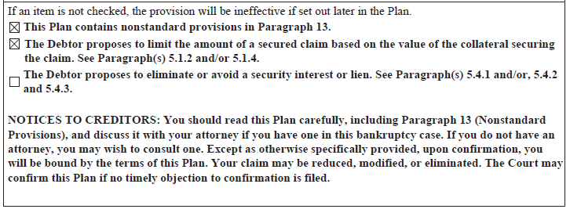
Check Boxes on Front Page
  Cramdown, lien avoidance, or use of Paragraph 13
  “If an item is not checked, the provision will be ineffective if set out later in the Plan”
35

Slide 39
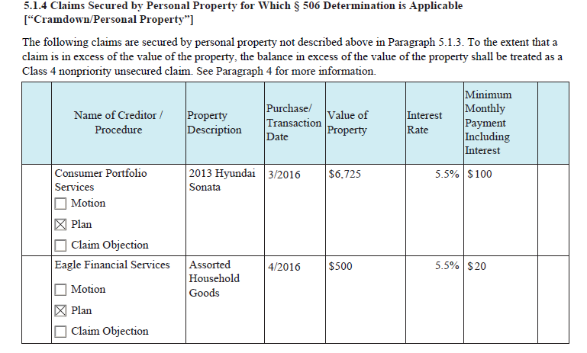
Failure to Fill in the Cramdown / Lien Avoidance Provisions Fully
  Creditor’s name must be specified.
  Check the box for procedure to effectuate cramdown or avoidance.
  Information should match what is in the motion or claim objection.
36

Slide 40

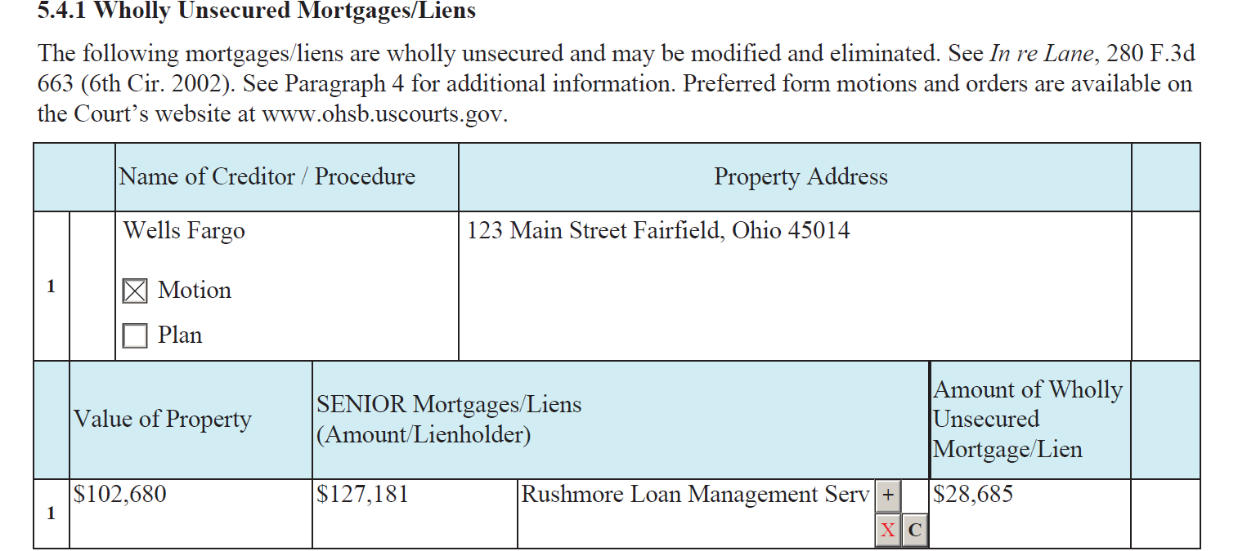
Fill out Table
37

Slide 41
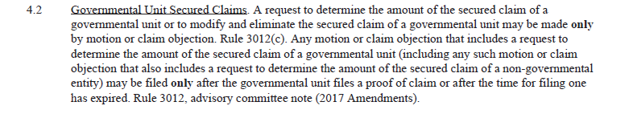

Attempting to Cramdown Government Claim By Plan
Attempting to Avoid Government Lien Before Claim Filed / Deadline Expired
  Both are prohibited by Rule 3012(c) and Plan Para. 4.2
38

Slide 42
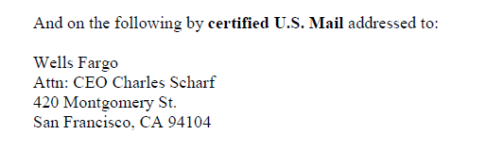
Failure to Indicate Proper Rule 7004 Service
  Cramdown / avoidance creditor must be served per Rule 7004
  If by motion (or by claim objection for cramdown), only the motion or claim objection requires Rule 7004 service
  If by plan, then the plan requires Rule 7004 service
  Certificate of service must demonstrate proper Rule 7004 service of plan
39

Slide 43

C. Lien Avoidance Issues
Rule 7004 service required
Differences between:
  motions to avoid a wholly unsecured mortgage under § 506;
  a motion to avoid a judicial lien that impairs exemptions under § 522(f)(1)(A); and
  a motion to avoid a non-PMSI in certain exempt personal property under § 522(f)(1)(B).
All information demonstrating entitlement to relief should be set forth
Fillable form motions & orders on the court’s website - strongly encouraged!
Under “Rules and Forms” / “Local Form Motions and Orders”
40

Slide 44
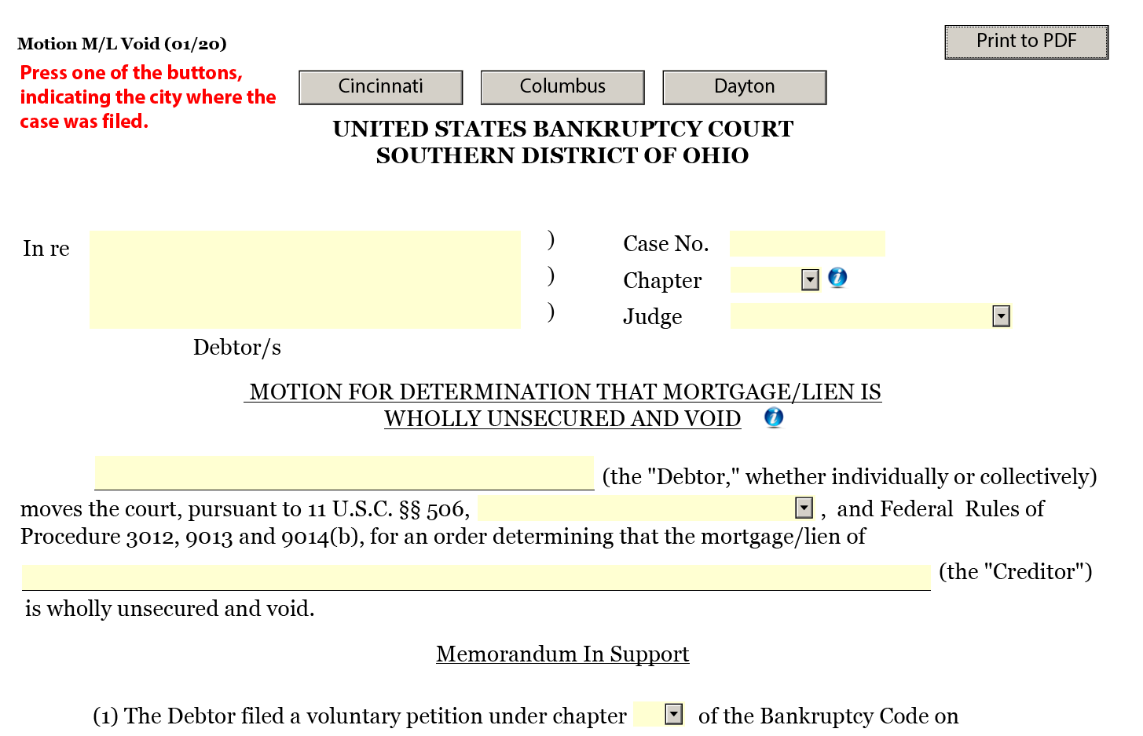
41

Slide 45

D. Order Submission Issues and Agreed Orders
Agreed Orders
  Make sure all interested parties sign the agreed order!
      Marge Burke’s requirements for Motion to Modify
    In a Chapter 13 case, usually the Chapter 13 trustee should sign the order, particularly if it impacts distribution or administration of the plan.
    Judges Buchanan and Humphrey will allow agreed orders without the filing of an underlying motion or AP if all affected parties sign off on the agreed order.
42

Slide 46

  Be sure that agreed orders pursuant to General Order 42-1 for suspension of Chapter 13 plan payments have the necessary information: a statement that a change in payments is needed because of COVID-19 and a negative notice.
  Also, remember that getting a forbearance from the lender is only the first step. Debtor counsel needs to work with the 13 office to determine how a forbearance impacts distributions and whether an agreed order for a suspension of payments is needed.
43

Slide 47
E. Motions for Relief and to Extend or Impose the Stay
Motions for Relief from Stay
  Identify the ground for which your client is seeking relief from stay, e.g. § 362(d)(1) for cause or § 362(d)(2) lack of equity and not necessary for an effective reorganization.
  Attach the appropriate documentation under LBR 4001-1.
  Mandatory form motions are coming soon for most routine relief from stay motions in Chapters 7 and 13!
Motions to Extend the Stay or to Impose the Stay
  Update the schedules before you file a new case—don’t just file the same schedules filed in a prior case, even if the dismissal was very recent.
  Explain why the circumstances are different, leading to the debtor’s ability to successfully complete a Chapter 13 case.
44

Slide 48
F. Motions to Retain Funds in Chapter 13 from Tax Refunds, Personal Injury Settlements, and Other Sources
Obtain court approval before the debtors spend the funds
Document the proposed expenditures to the extent appropriate
If there has been a change in circumstances creating a specific need, amend the schedules or otherwise bring to the court’s attention the change in the circumstances
The court reviews the schedules and docket to assess how the proposed expenditure fits with the rest of the case
COVID-19 situation: How long has the debtor been unemployed or underemployed, and what, if any, replacement income from unemployment or other sources has the debtor received.
Attached estimates for work that needs to be completed is helpful and may avoid a hearing or the need to supplement the motion
45

Slide 49

G. Expedited Relief (Shorten Time / Expedited Hearing)
Local Bankruptcy Rule 9073-1
Separate motion from underlying filing
Identify:
proposed shortened notice / response time / expedited hearing date
  reasons needed
  parties affected
  method of notification
Per General Order 12-3:
  no 21-day notice on motion to shorten time / expedite hearing (so upload proposed order granting expedited relief immediately)
21-day notice should be included on underlying filing
If granted, file certificate of service evidencing expedited notice
Check Judge’s specific procedures on court website if want expedited review of motion, contact chambers
46

Slide 50
H. Motions to Vacate Dismissal in a Chapter 13 Case
Generally, a motion to vacate a dismissal of a Chapter 13 case should cite to Federal Rule of Civil Procedure 60(b).
Provides the specific factual circumstances in the case that would justify vacating a dismissal order.
Do not simply ask to “reinstate the case.”
Seek to extend a deadline or modify a plan to avoid dismissal whenever possible. Vacating a dismissal should be a last resort.
47

Slide 51

I. Fee Applications
Include descriptions of work performed and time spent on each matter, in 1/10 of an hour increments
Provide sufficient detail, but do not include client confidential information and communications
Identify the person doing the work and what that person’s position is (e.g. attorney, paralegal) and that person’s hourly rate
Assess the reasonable value of the work performed and reduce if appropriate.
48

Slide 52

Submit fee applications after work is completed on a discrete matter, but not later than six months from the work being done. See LBR 2016-1(b)(3).
A fee application in a case dismissed prior to confirmation must be filed within 14 days of the entry of the dismissal order. LBR 2016-1(b)(5).
A fee application of more than $1,000 must be served on all creditors and parties in interest.
If you opt out of the no-look fee, you must submit a fee application itemizing all fees within 60 days of the entry of the confirmation order. LBR 2016-1(b)(2)(C).
49

Slide 53
J. Other Motion and Application Issues
Motions to Avoid Liens Pursuant to § 522(f)
  Make sure you identify the exemption being impaired, including the appropriate Ohio Revised Code section
Motions to Avoid Wholly Unsecured Liens Pursuant to § 506
  Do not combine with § 522(f) concepts. Exemptions are not relevant for a § 506 analysis.
50

Slide 54
Preference actions 11 U.S.C. § 547
Must file an AP to avoid liens based upon a preference theory (or enter an agreed order.)
In a Chapter 13, state as a special plan provision that you are going to file an AP seeking to avoid the lien on that basis, but you cannot provide for the lien removal through the plan
51

Slide 55

Redemption Motions
  Redemption motions must be served pursuant to Rule 7004. Consider using the court’s optional form motion and order. Disclose any separate attorney fee you are receiving.
363 Sale Motions
  Serve sale motions on all creditors and parties in interest. Attach relevant documents on the payout of any settlement. If the sale is free and clear of any interest in the property, clearly indicate that is the case and cite which sub-sections of § 363(f) apply.
Rule 9019 Compromise Motions
  Settlements that affect all creditors must be filed pursuant to Rule 9019 and served on all creditors and parties in interest.
52

Slide 56

Retention of Special Counsel
  Chapter 13
    Must be filed by Chapter 13 Trustee or the Debtor’s counsel – cannot be filed by special counsel
    File Application to Retain Special Counsel sooner rather than later. Don’t wait until a personal injury, workers compensation, or other litigation claim is resolved to obtain approval of counsel
  Chapter 7
    Trustee files application to retain special counsel. Debtor can only pursue such an action if the Trustee abandons it, and then there is no need to file a retention motion with the court.
  Information Needed:
    Application
    Affidavit of Counsel
    Terms of Employment
53

Slide 57

Responses to Motions or Applications:
Avoid “place holder” objections or responses such as “I object” or “The claim is correct in all respects.”
Must state the substantive or procedural basis for objecting to the motion or application, including any factual and legal basis for objecting to the relief being sought.
54

Slide 58

K. Reaffirmation Agreements
The reaffirmation agreement must be accompanied by Official Form 427 (Cover Sheet).
Make sure the debtor and the creditor have each signed the reaffirmation agreement before it is filed.
Make sure one of the boxes on the top of the first page of the reaffirmation checked indicating whether there is or is not an undue hardship is checked.
If counsel signs the reaffirmation agreement also make sure the box above counsel’s signature is checked indicating that although there is a presumption of undue hardship exists counsel feels the debtor can make the payment.
If debtor’s budget is running a deficit, explain how the debtor is going to make the payments.
The payment for the reaffirmed debt must be included in debtor’s Schedule J. If the debtor’s income or expenses have changed file amended schedules I or J as appropriate.
55

Slide 59
L. Claim Objections and Responses: Rule 3007
30-day notice
Serve claim objection on notice address
Additional Rule 7004 service required when:
    Claim of United States or its officers / agencies – Rule 3007(a)(2)(A)(i)
    Claim of an insured depository institution – Rule 3007(a)(2)(A)(ii)
    Using claim objection for cramdown - General Order 22-2 and Plan ¶ 4.3
Relief in claim objection and proposed order should match
Do not request disallowance in full if not warranted
Difficulties arise when creditor files an amended claim rather than a response
56

Slide 60


M. Adversary Issues: Complaint, Answer and Default Motions
Complaint
    Differentiate between §727 and §523(a)
    Separate count for each separate claim for relief
        E.g., separate count for § 523(a)(2)(A) (fraud) and §523(a)(6) (willful and malicious injury)
    Include sufficient facts
        Necessary to survive motion to dismiss under Twombly & Iqbal
    Ensure that prayer for relief is consistent with claims
57

Slide 61
Answer (Rule 7008 / FRCP 8)
  Cannot state general denial of all allegations unless in “good faith”
  Otherwise should separately address each paragraph of the complaint.
  May also indicate denial for “lack of knowledge or information sufficient to form belief about the truth of the matter asserted.
  Include all affirmative defenses (fraud, res judicata, statute of limitations, etc.) FRCP 8(c)
  Include Rule 12 defenses
58

Slide 62
Motion for Default Judgment
Requires:
  If defendant is an individual, an affidavit stating:
    Whether defendant is in the military. (Servicemembers Civil Relief Act).
      May search records at the Servicemembers Civil Relief Act Website: https://scra.dmdc.osd.mil/scra/#/login
    Whether defendant is a minor or incompetent person. Rule 7055(b).
59

Slide 63
N. Summary Judgment Issues
Rule 7056 / FRCP 56
Standard of review
    Granted if “no genuine dispute as to any material fact and the movant is entitled to judgment as a matter of law.” FRCP 56(a)
All assertions of fact must be supported by citing to particular parts of materials in the record:
    Examples: affidavits, documentary evidence, stipulations, admissions, interrogatory answers, depositions or other materials
    A party opposing summary judgment cannot rest on its answer
Summary judgment does not embrace default judgment principles
60

Slide 64
O. 7004 Service
Generally, you need Rule 7004 service when a creditor is being directly affected.
Specifically, it is always required in these circumstances:
    A claim objection involving the United States or an FDIC Bank. The notice address of the proof claim AND 7004 service is required to be served.
    Avoiding a lien or a cramdown of a secured claim in a Chapter 13 Plan.
    Motions to Avoid a Lien
    Motions to Redeem
    Motions seeking extraordinary relief, such as damages for contempt or a stay violation
61

Slide 65
How do I serve certain parties?
  United States: Serve by either first class, certified or registered mail addressed to:
    the civil-process clerk at the United States attorney’s office;
    Attorney General of the United States at Washington, D.C.; and
    the agency.
  Corporate Entity: Serve either:
    to the attention of an officer or agent of the corporation by first class mail
    or
    by certified or express mail to any of a corporation’s usual places of business.
62

Slide 66
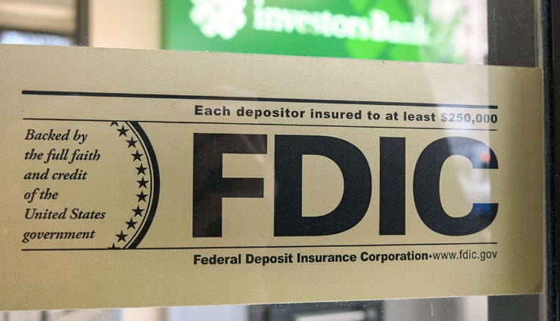
FDIC Bank:
Is the entity an FDIC Bank?:
See https://research2.fdic.gov/bankfind
Serve to the attention of a specific officer of the bank by certified mail. List the name and title of the officer.
Exception if attorney for the bank has appeared in the case. Serve the attorney by U.S. mail. Do not rely on ECF Service.
63

Slide 67
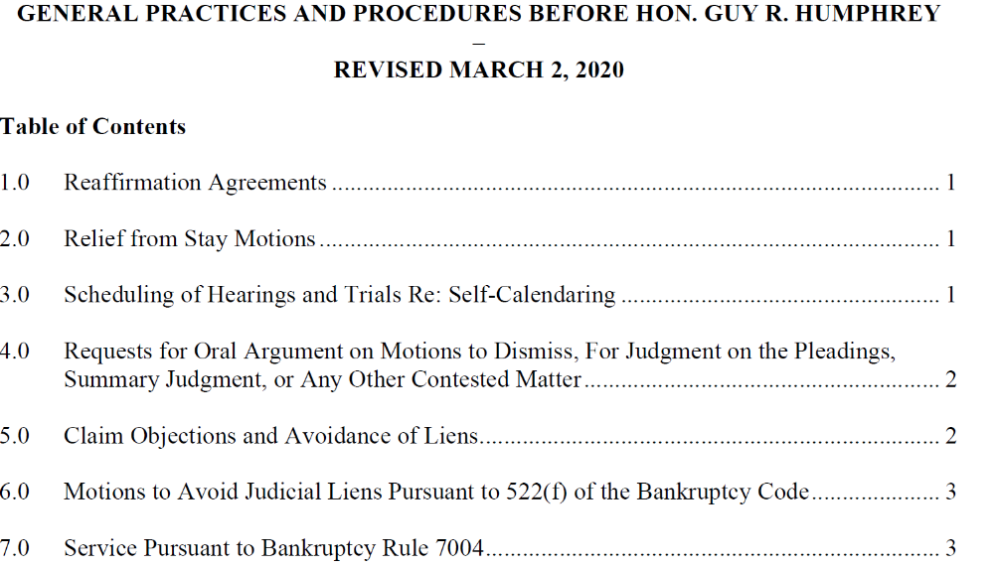
64

Slide 68
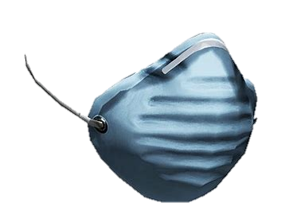

THANK YOU FOR JOINING US!
STAY SAFE

